Slide 1
Task 5
7/14/2023

Slide 2
Pose evaluation
Visual clustering
Audio Process & clustering

Slide 3
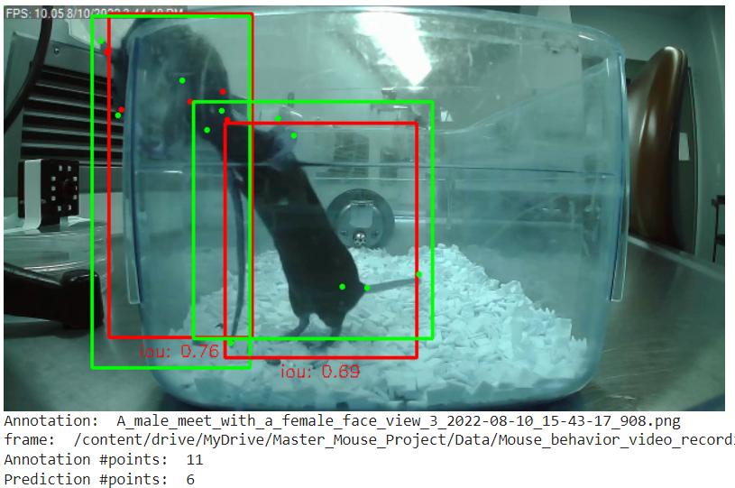
1. Pose visualization
Improvements
Bounding boxes with highest IOU
including IOU value

Slide 4
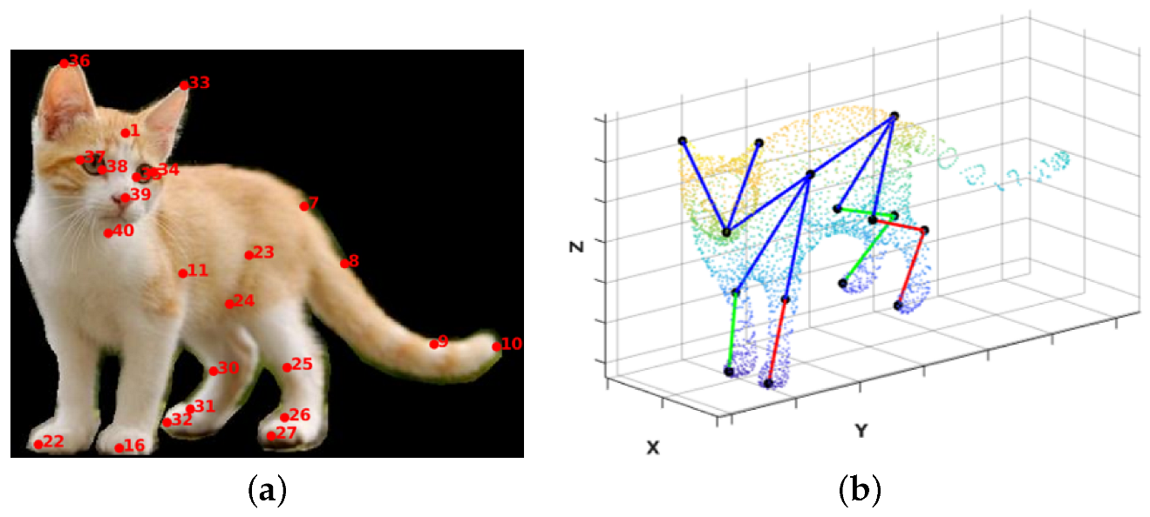
Visualization Conclusions
Improving proposals
Include points description (head, hip, tail…)
Include information about body structure

Slide 5
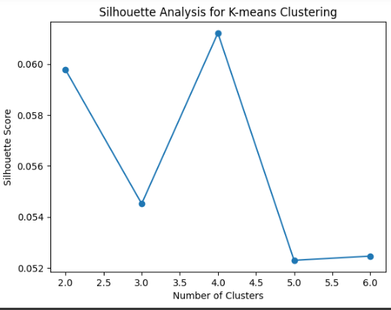
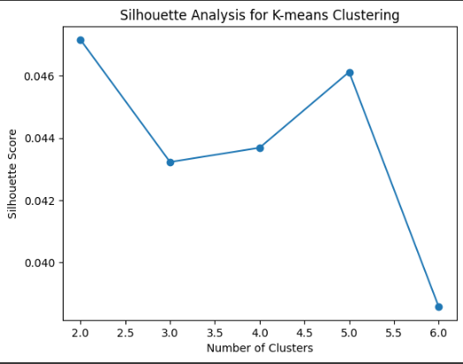
2. Visual clustering
Sliding window:
Use 20 consecutive frames
Every 5 frames a new row is created
From 36 to 147 rows of data

Slide 6
2. Visual clustering
Next steps
Join top/side/face files
Manually identify each point to each part of the mouse
Use other datasets

Slide 7
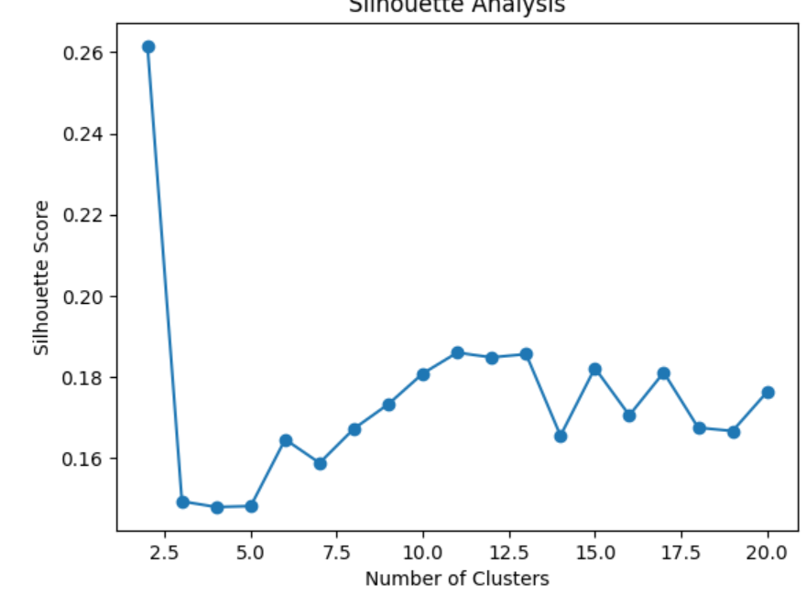
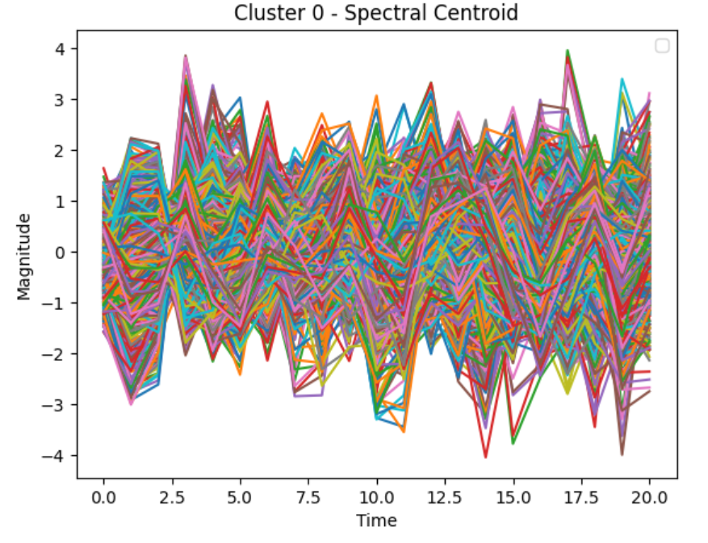
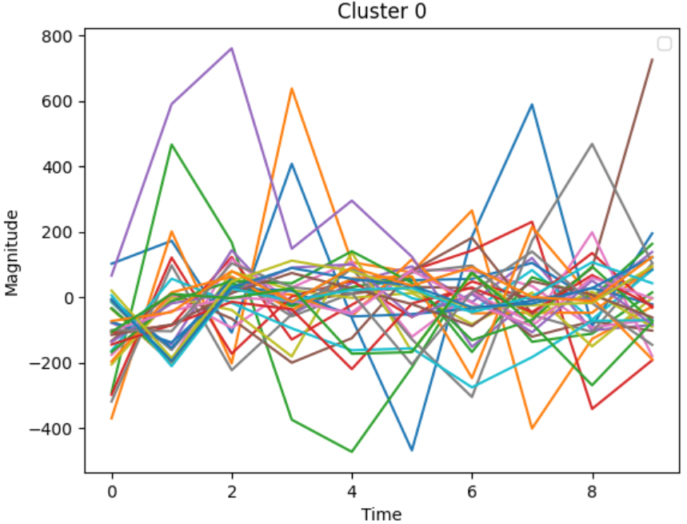
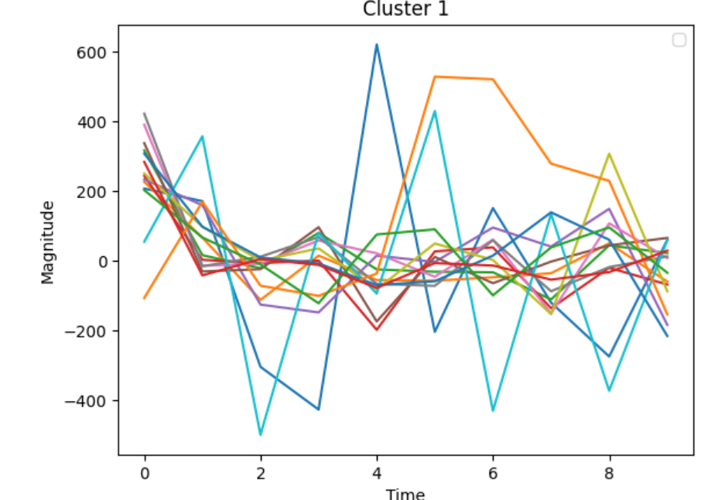
3. Audio Process & clustering
4. Perform clustering
5. Analyze results
1st analysis: plots the 10-dimensional feature vectors for each sample in each cluster (after PCA).
PREVIOUSLY SO MANY FEATURES
NOW 10 FEATURES

Slide 8
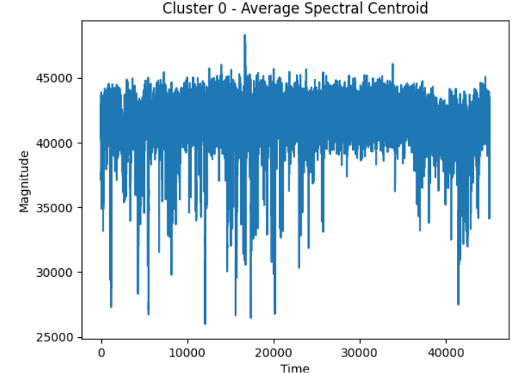
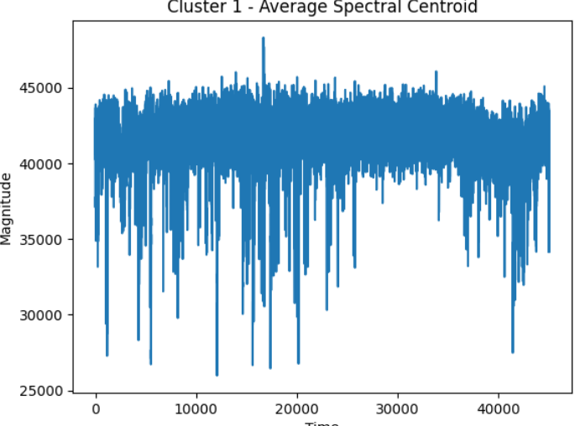
3. Audio Process & clustering
5. Analyze results
2nd analysis: computes average spectral centroid for each cluster by looping over each cluster (identified by a unique label), selecting the spectral centroids for the files in that cluster, and then computing the mean of these spectral centroids.

